Slide 1
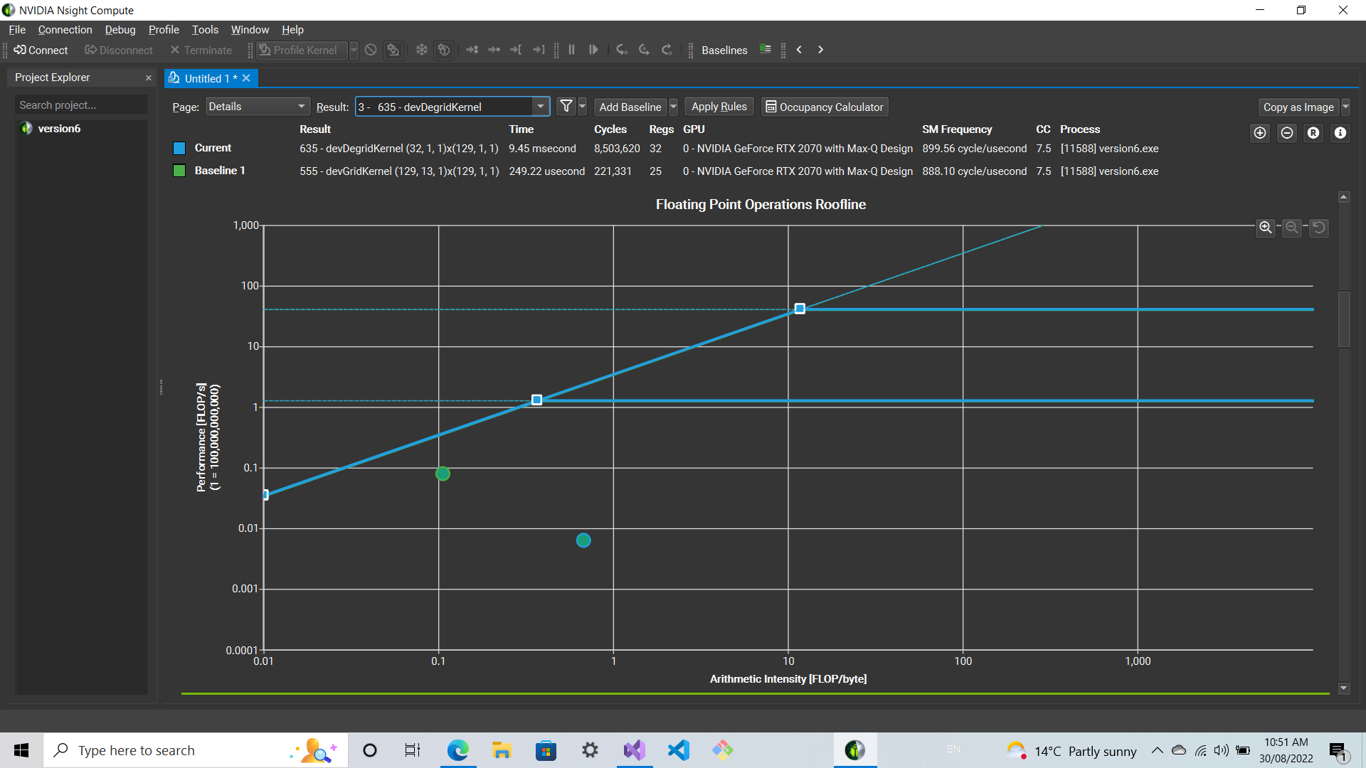
GPU kernels of YandaSoft
A brief introduction & GPU Pacer Sprint results
Ozgur Cekmer | 18 October 2022

Slide 2
Contents
Goals for the GPU PACER Sprint
Kernels, operations, goals
Convolution
Gridding
Degridding
Deconvolution
CLEAN
GPU PACER Sprint
What is aimed:
Performance results on Day 0
What is achieved:
Performance results on Day 5
Design Patterns
Strategy pattern
Factory pattern
Implementation on the deconvolution code
Conclusions & Future work

Slide 3
Sprint Team
Stephen Ord | PI | CSIRO
Daniel Mitchell | Developer | CSIRO
Ozgur Cekmer | Developer | CSIRO
Pero Manojlovic | Developer | CSIRO
Pascal Elahi | Technical POC | Pawsey Centre
Joseph Schoonover | Mentor | Fluid Numerics

Slide 4
Section 1
Goals for the GPU PACER Sprint

Slide 5
GPU Kernels of YandaSoft
Convolution
Gridding
Degridding
Deconvolution
Högböm CLEAN
Operations
Matrix ops
Reductions
Initial versions
CUDA
Target
HIP
Performance optimization for the kernels

Slide 6
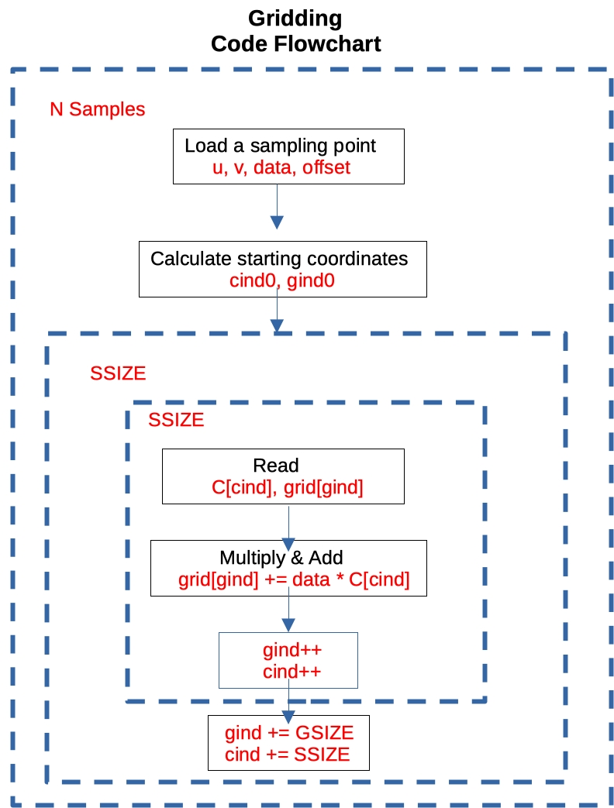
Convolution - Gridding
Gridding
To utilize FFT, the visibility data must be transformed to a regular grid.
This method is called convolutional sampling.
The visibility data are sampled at discrete locations in a 2D space.
These data are then converted into a smooth function by convolving with a finite-size kernel.
* Adapted from Figure 6.3 of Big Data of Astronomy, Chapter 6 - Processing data of correlation on GPU, Y. Zhu, J. Hou, Y. Song, Y. Zheng, T. Huang, H. Wu, 2020.

Slide 7
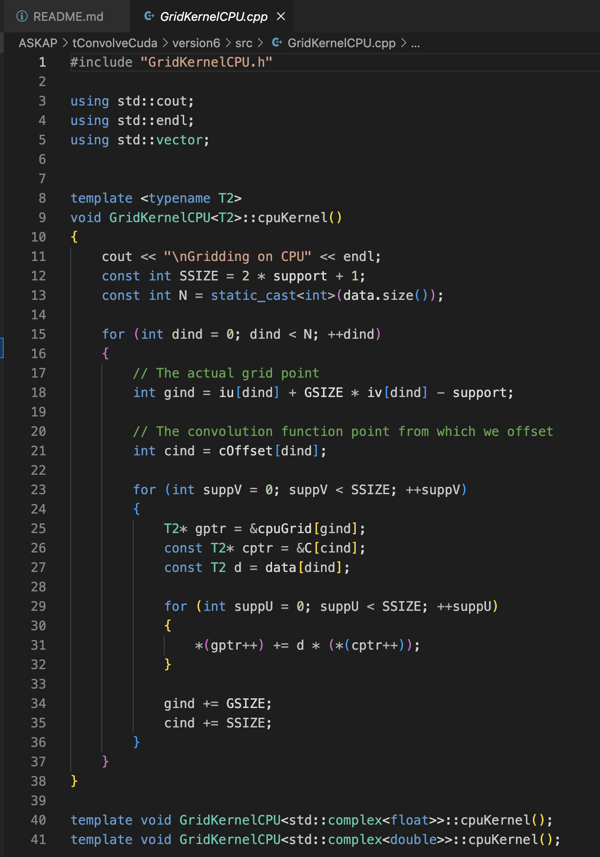
Convolution - Gridding
* Adapted from Figure 6.3 of Big Data of Astronomy, Chapter 6 - Processing data of correlation on GPU, Y. Zhu, J. Hou, Y. Song, Y. Zheng, T. Huang, H. Wu, 2020.

Slide 8
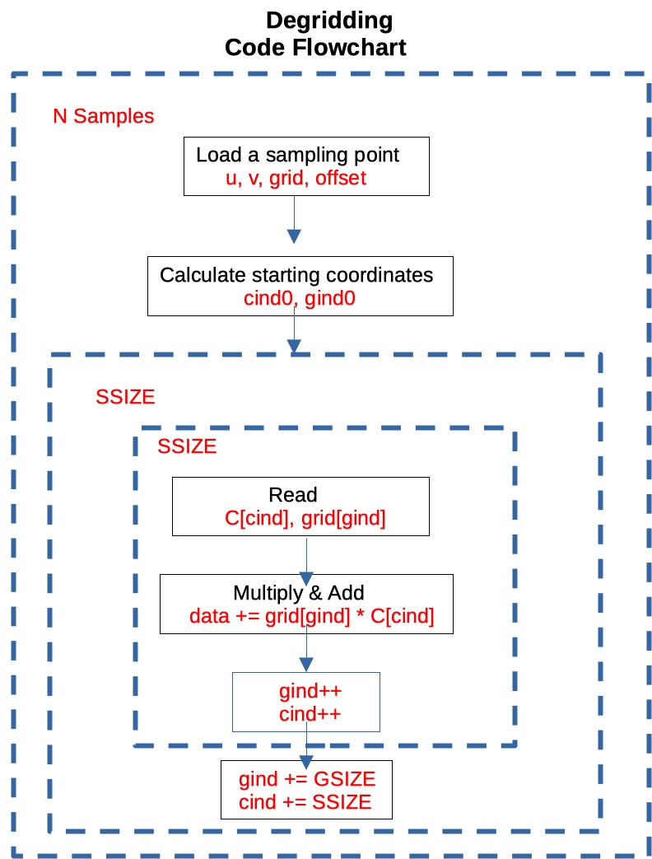
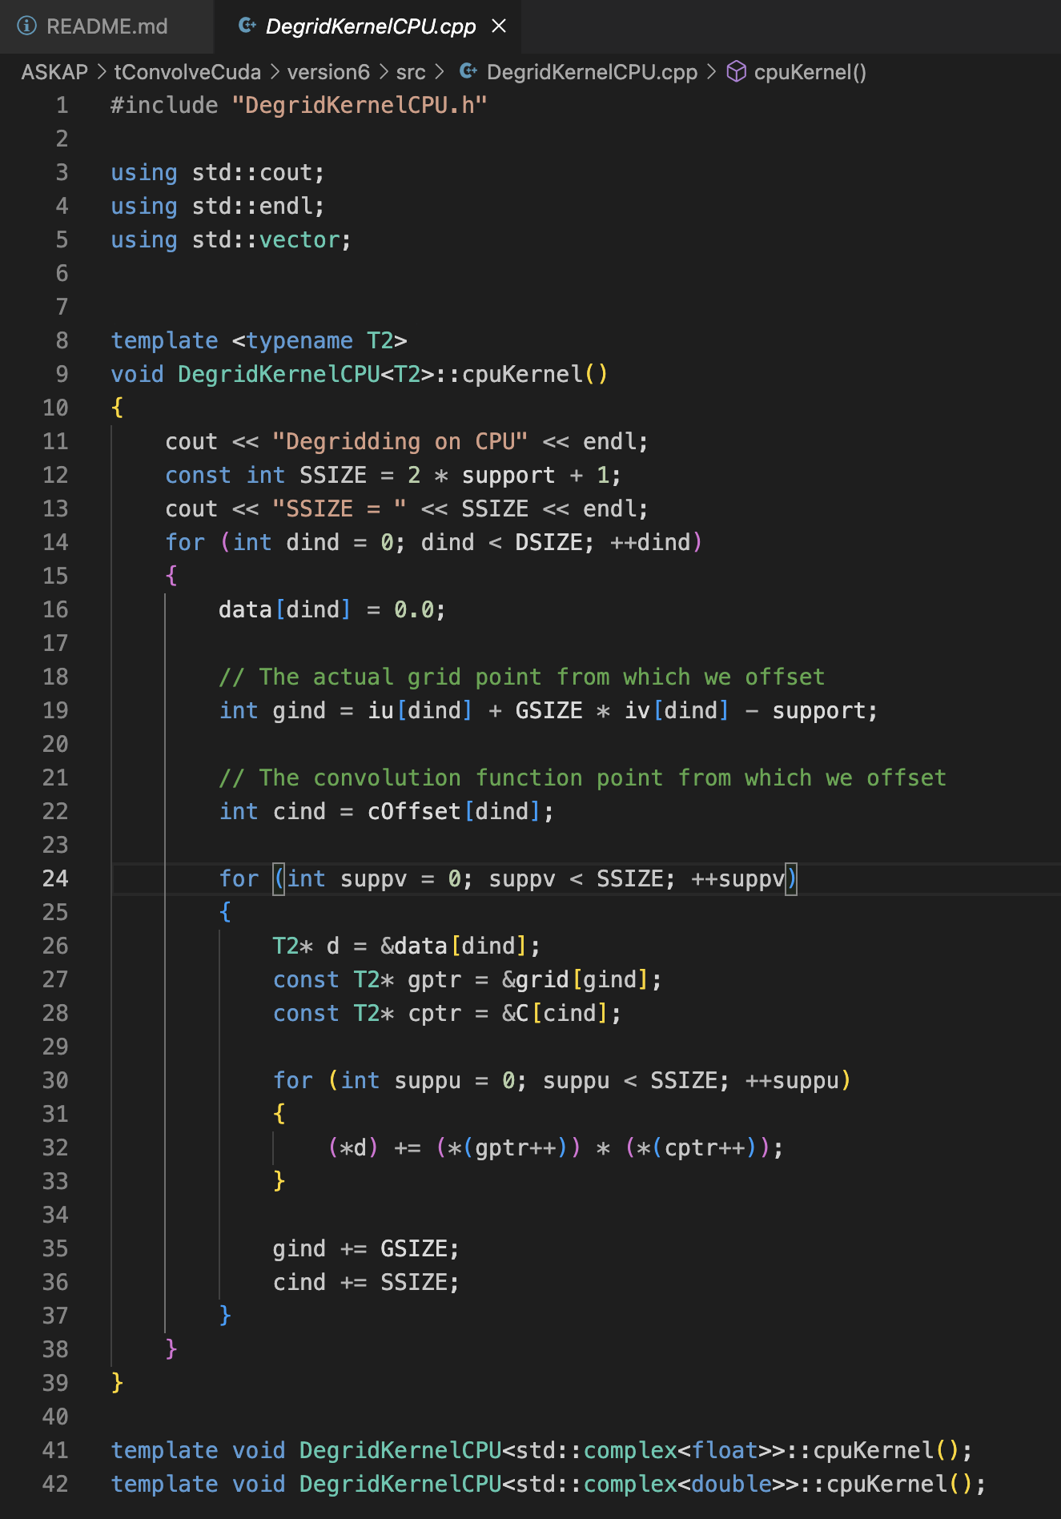
Convolution - Degridding
* Adapted from Figure 6.3 of Big Data of Astronomy, Chapter 6 - Processing data of correlation on GPU, Y. Zhu, J. Hou, Y. Song, Y. Zheng, T. Huang, H. Wu, 2020.

Slide 9
Deconvolution – Hogbom’s CLEAN algorithm
Methodology
Start with the dirty image
Find the brightest pixel
Subtract a fraction (loop gain: around 0.1) of the dirty beam from the dirty image at the location of that brightest pixel.
The subtracted image is called the residual image.
Find the new brightest pixel.
Continue the loop until a threshold is reached.

Slide 10
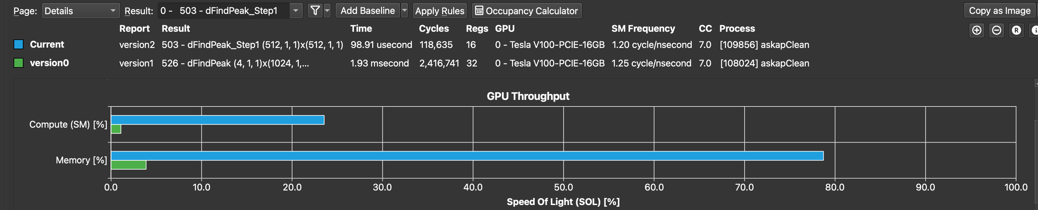
Section 2
Results
Deconvolution
Gridding
Degridding

Slide 11
Deconvolution – Högböm’s Clean Algorithm
Day 0
The main kernel: findPeak
The second kernel: subtractPSF
CUDA kernels on TOPAZ (V100)
Benchmarking problem
Size: ~16M
2 kernels
findPeak
subtractPSF
 | Version 0
Speedup | 11.18

Slide 12
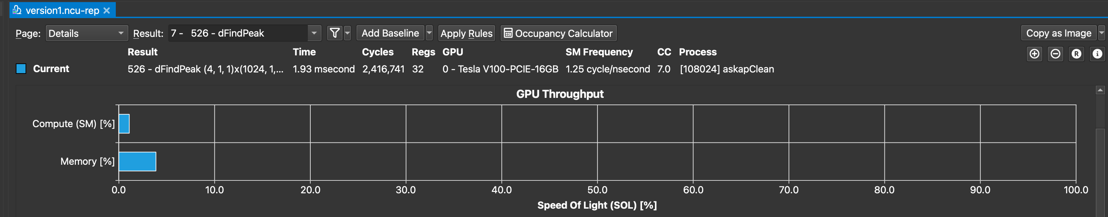
Deconvolution – Högböm’s Clean Algorithm
Day 0
Shared memory
The main kernel: findPeak
The second kernel: subtractPSF
CUDA kernels on TOPAZ (V100)
Benchmarking problem
Size: ~16M
2 kernels
findPeak
subtractPSF
 | Version 0
Speedup | 11.18

Slide 13
Deconvolution – Högböm’s Clean Algorithm
Day 1
HIP kernels on MULAN (MI100)
Codes HIPified
 | Version 0
 | TOPAZ | MULAN
Speedup | 11.18 | 6.38

Slide 14
Deconvolution – Högböm’s Clean Algorithm
Day 5
findPeak was optimized:
A parallel reduction (AKA parallel sweep, tree approach, sequential addressing) was implemented with a grid-stride data load
A 2-step method was applied to extract the peak value and the index.
CUDA results on TOPAZ (V100).

Slide 15
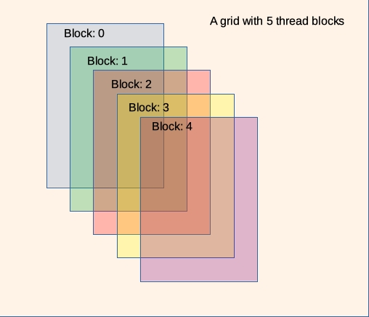
Deconvolution – Högböm’s Clean Algorithm
Optimisation methodology
A parallel sweep in 2-steps
<<<blocksPerGrid, threadsPerBlock>>>
Notes:
Chevron

Slide 16
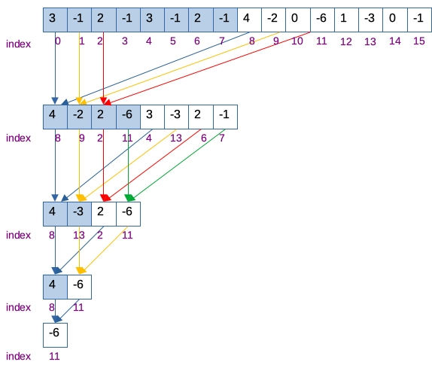
Deconvolution – Högböm’s Clean Algorithm
Optimisation methodology
A parallel sweep in 2-steps
<<<blocksPerGrid, threadsPerBlock>>>
Max value and location:
Step 1: in each block
Step 2: in the entire grid.
Launch Configuration:
Step 1: <<<256, 256>>>
Step 2: <<<1, 256>>>

Slide 17
Deconvolution – Högböm’s Clean Algorithm
Day 5 - findPeak
findPeak | V100 | MI100
Speedup vs Version 0 | 18.42 | 19.92
 | Version 0 |  | Version 1
 | TOPAZ | MULAN | TOPAZ | MULAN
Speedup | 11.18 | 6.38 | 55.01 | 38.60

Slide 18
Deconvolution – Högböm’s Clean Algorithm
Day 5

Slide 19
Deconvolution – Högböm’s Clean Algorithm
Day 5

Slide 20
Deconvolution – Högböm’s Clean Algorithm
Day 5
Notes:
Hyphothesis

Slide 21
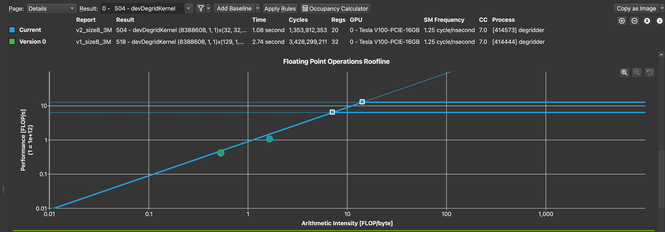
Convolution – Degridding kernel
Day 0 vs Day 5
Parallel reduction to calculate the sum
A new launch configuration was applied
<<<gridSize, blockSize>>>
gridSize: # of blocks = separate data (computations are independent of other blocks)
blockSize: dim3(32, 32, 1)

Slide 22
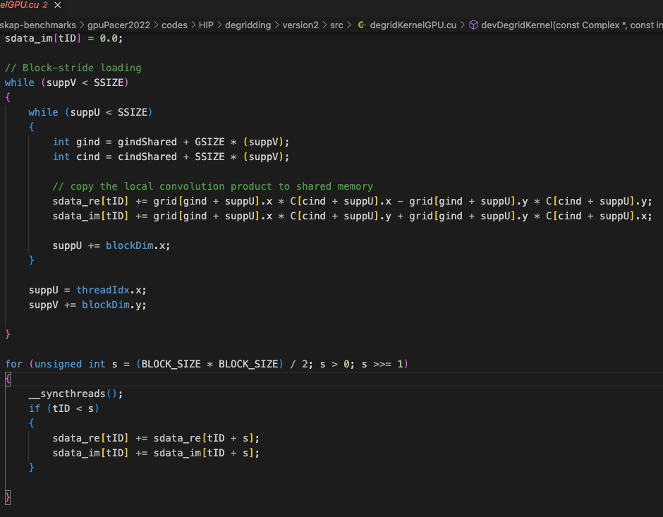
Convolution – Degridding kernel

Slide 23
Convolution – Degridding kernel
Day 0 vs Day 5
degridKernel | V100 | MI100
Speedup vs Version 0 | 2.48 | 2.17

Slide 24
Convolution – Degridding kernel

Slide 25
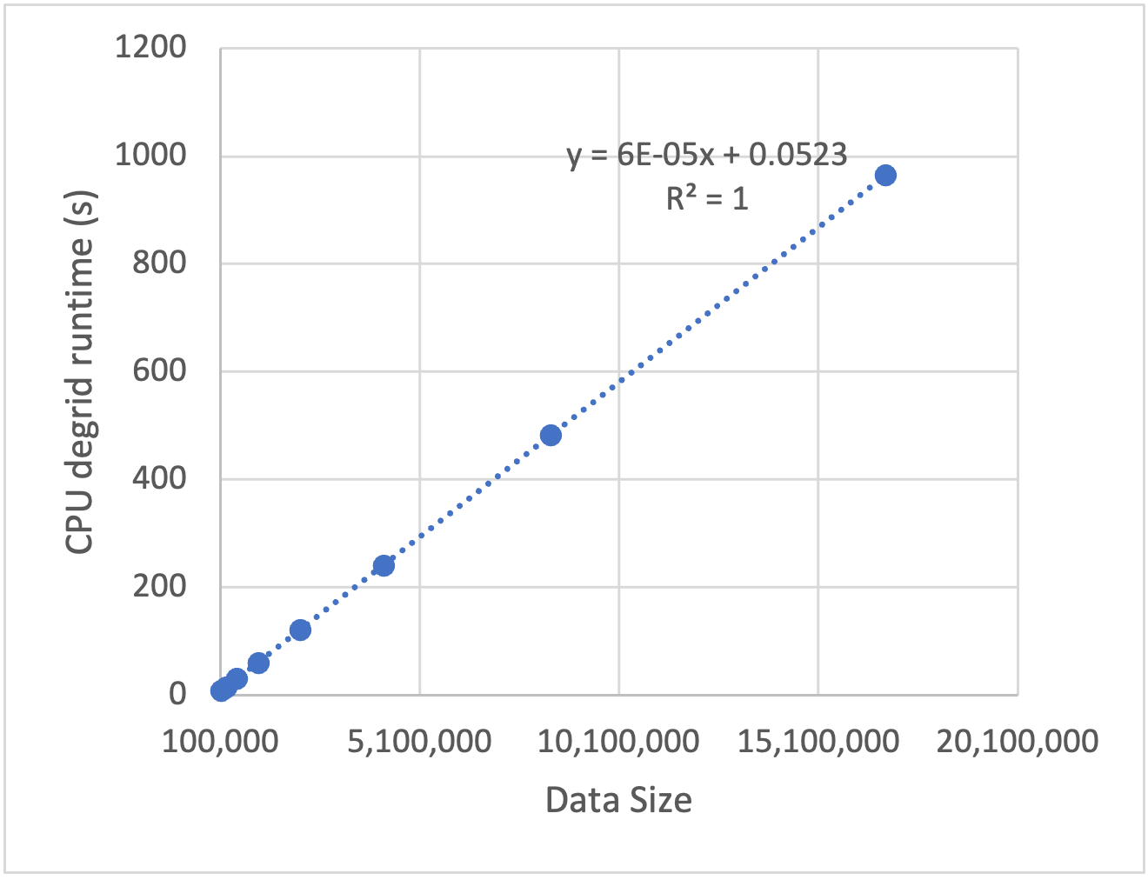
Convolution – Degridding kernel

Slide 26
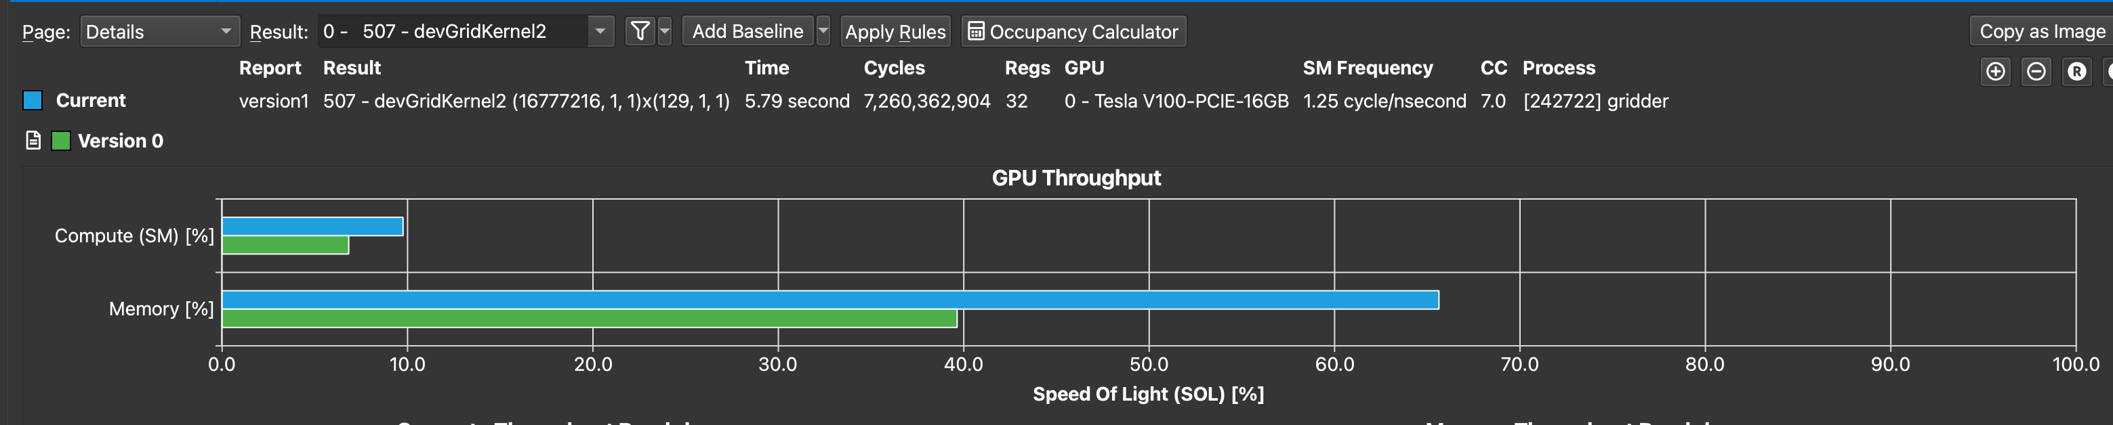
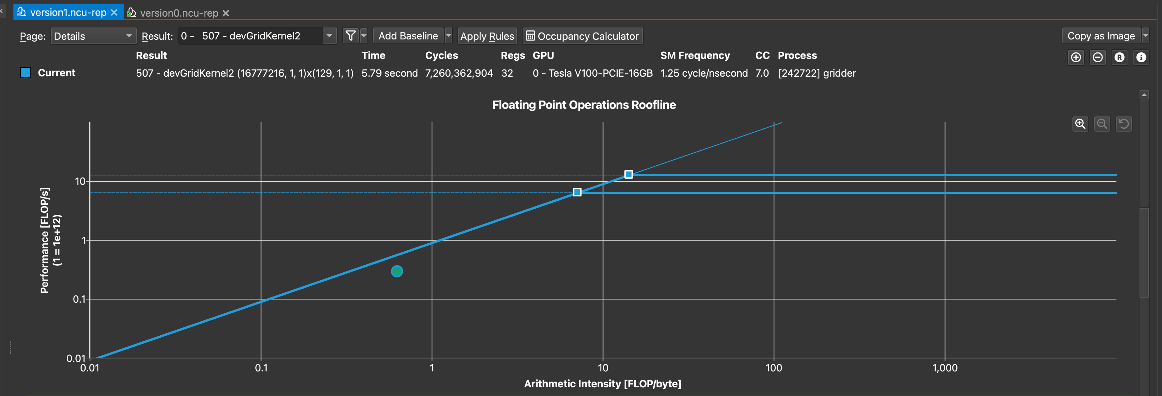
Convolution – Gridding kernel
Day 0 vs Day 5

Slide 27
Convolution – Gridding kernel
Day 0 vs Day 5
Gridding | V100
Speedup vs Version 0 | 4.04

Slide 28
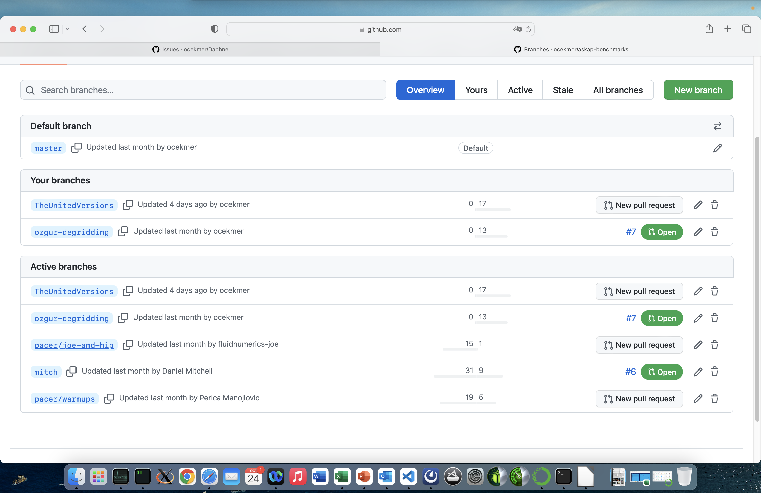
Section 3
Version problems

Slide 29
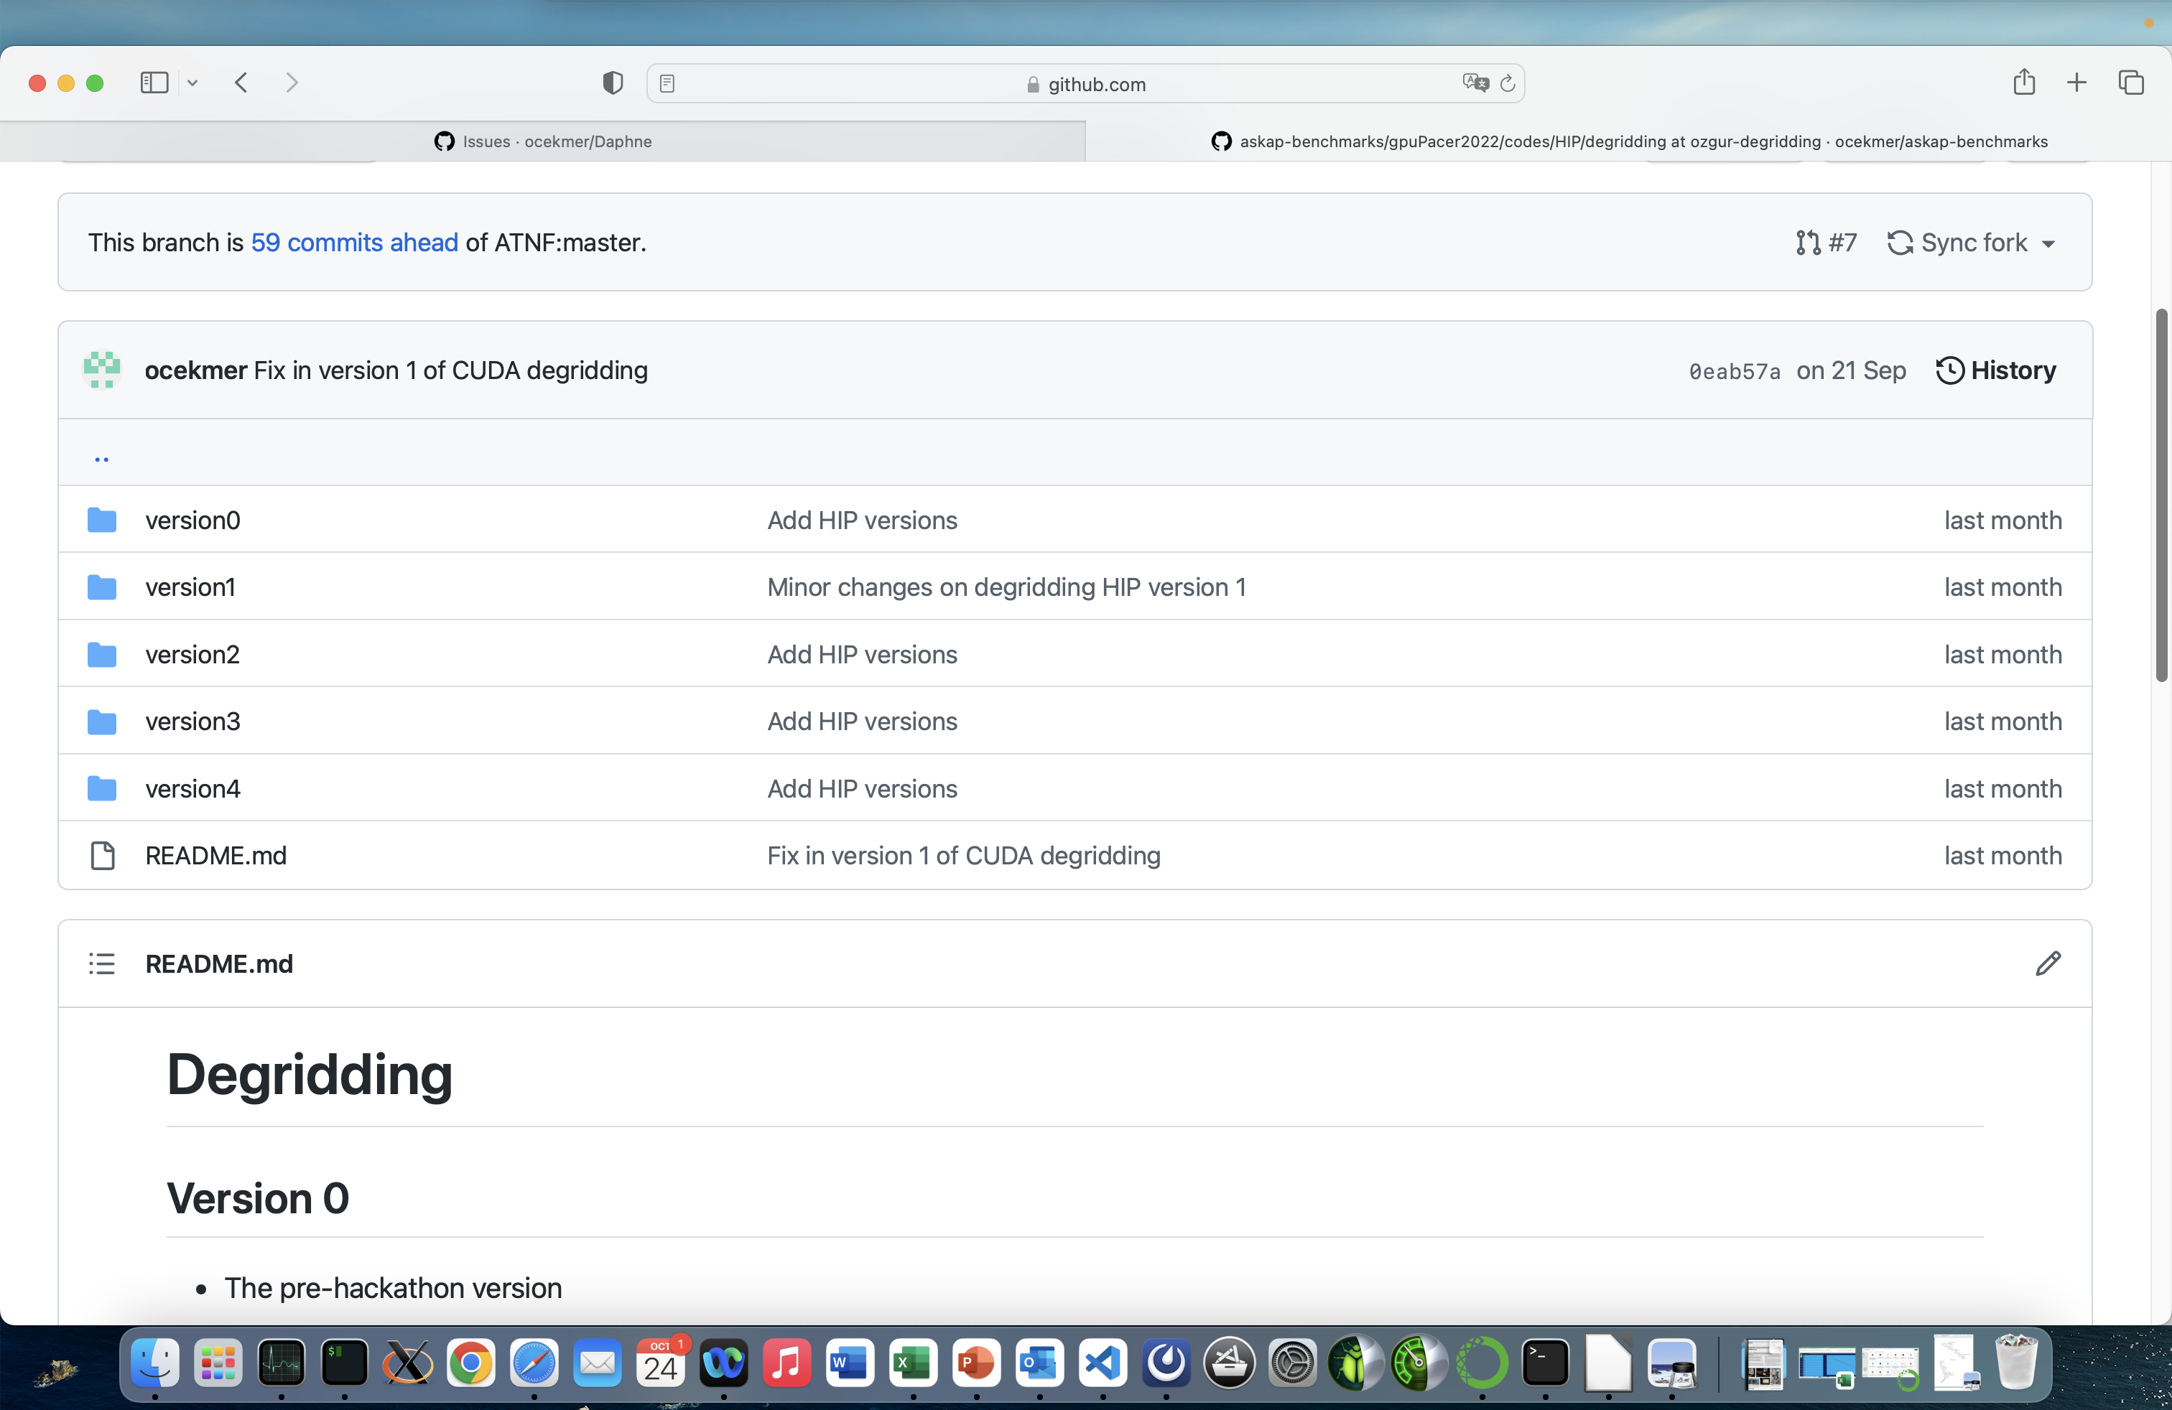
Version problems
Too many different versions with the same name
Difficult to merge

Slide 30
Version problems
Too many different versions with the same name
Difficult to merge
Solution: Design Patterns

Slide 31

Strategy Pattern
Identify the aspects of your application that vary
Encapsulate that part and separate them from what stays the same
Program to an interface, not an implementation

Slide 32
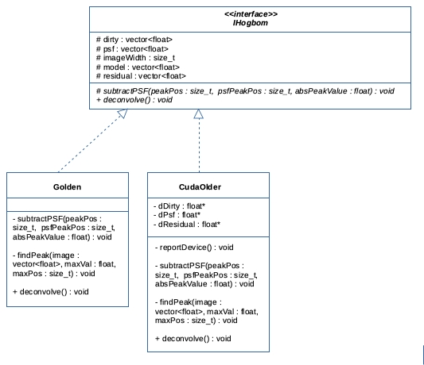
Strategy Pattern
Identify the aspects of your application that vary
Encapsulate that part and separate them from what stays the same
Program to an interface, not an implementation

Slide 33
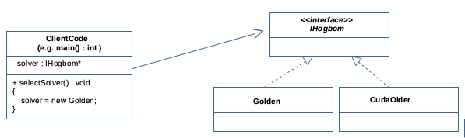
Strategy Pattern
Identify the aspects of your application that vary
Encapsulate that part and separate them from what stays the same
Program to an interface, not an implementation

Slide 34
Strategy Pattern
Easy maintenance

Slide 35
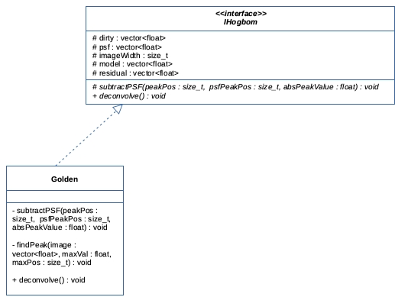
Strategy Pattern
Easy maintenance

Slide 36
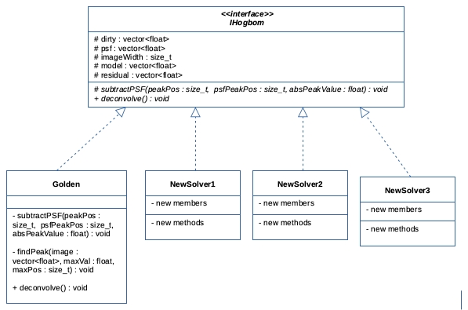
Strategy Pattern
Easy maintenance

Slide 37
Factory Pattern
Tying your code to a concrete class can make it:
More fragile
Less flexible
Limit the use of new operator
Shouldn’t always be done in public
Can often lead to coupling problems

Slide 38
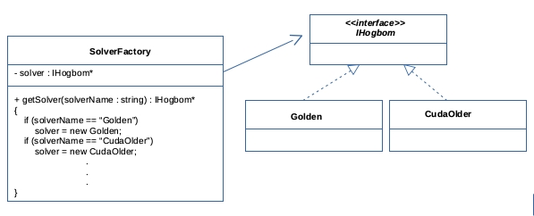
Factory Pattern
Tying your code to a concrete class can make it:
More fragile
Less flexible
Limit the use of new operator
Shouldn’t always be done in public
Can often lead to coupling problems

Slide 39
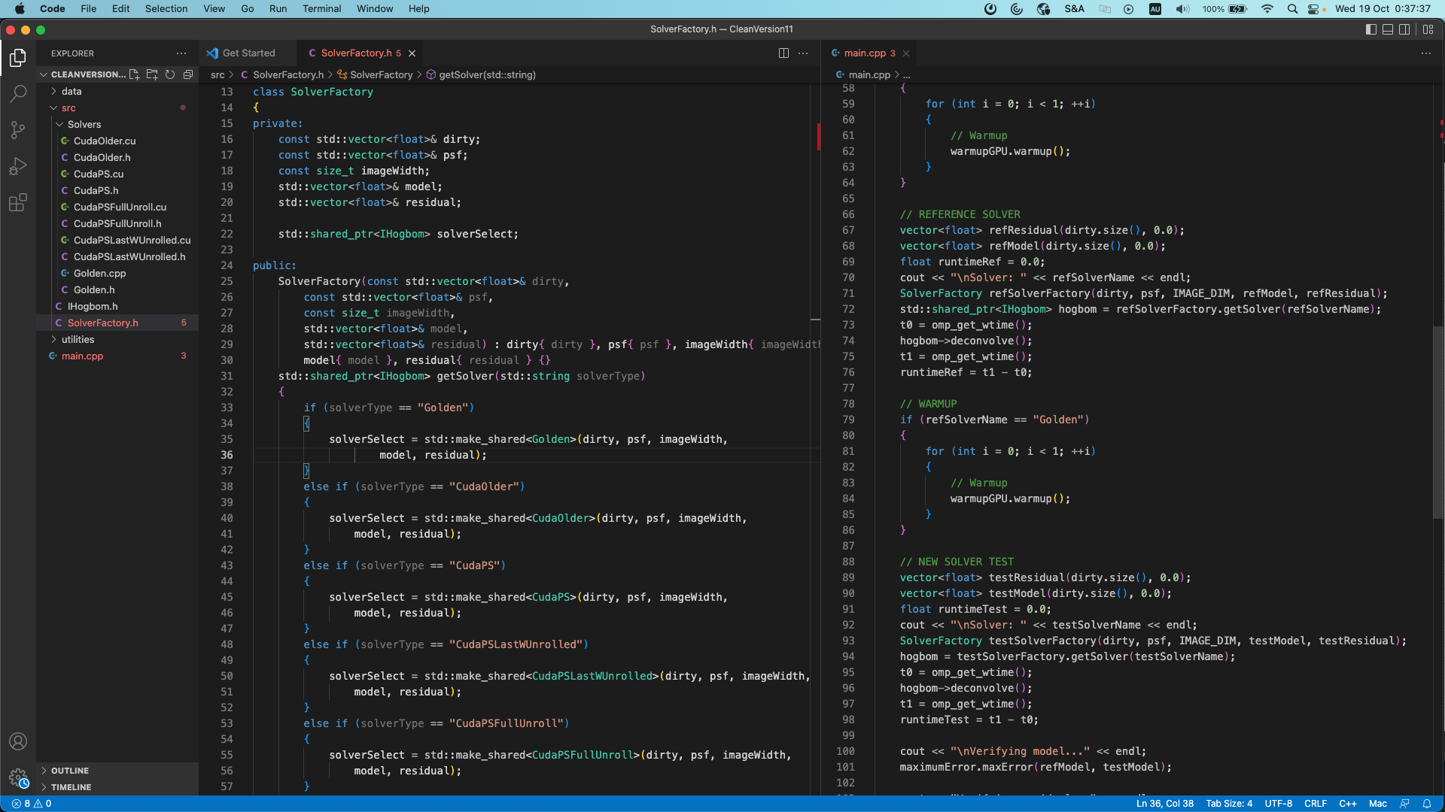
Factory Pattern

Slide 40
A little bit information of Warmup issue
The latest GPU code for CLEAN ran twice:
t₁ = 3.91 s t₂ = 2.62 s

Slide 41
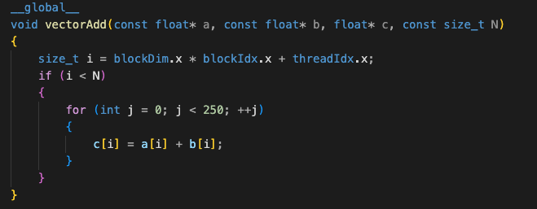
A little bit information of Warmup issue
The latest GPU code for CLEAN ran twice:
t₁ = 3.91 s t₂ = 2.62 s
The warmup code:

Slide 42
A little bit information of Warmup issue
The latest GPU code for CLEAN ran twice:
t₁ = 3.91 s t₂ = 2.62 s
The warmup code:

Slide 43
Conclusions & Future work
Achieved the following speedups (benchmark problem size: ~16M):
CLEAN ~39
Gridding ~51
Degridding ~309
Simple hipification
hipify-perl worked great; there is a few exceptions, which were converted manually (mostly cuComplex functions)
rocprof worked great to observe the code timeline
Collecting flops and bytes/s would be great
Roofline
A very interesting WARM-UP problem
Future work:
Ready to pass to multi-GPUs on CLEAN & Degridding codes
CLEAN runs for bigger problem sizes.
There is more room to optimize the Gridding kernel.
Clean-up the benchmark repo

Slide 44
Questions

